Slide 1


Foundations of
Scientific Computing
(SciComp 101)
Dave Biersach
dbiersach@bnl.gov
Session 08 Experiments in Math

Slide 2
Session 08 – Goals
This session is to reinforce skills using numpy vectorized operations and drawing graphs with matplotlib
Trigonometry allows us to convert Polar coordinates to Cartesian coordinates – if you haven’t covered this yet in your math class, don’t worry – glide with it
This session also seeks to affirm the importance of being able to derive from first principles classic formulas that thus far have just been handed to you – do more than memorize!
We will also cover how to generate random numbers, plot using Polar projections, and several topics from computational geometry

Slide 3
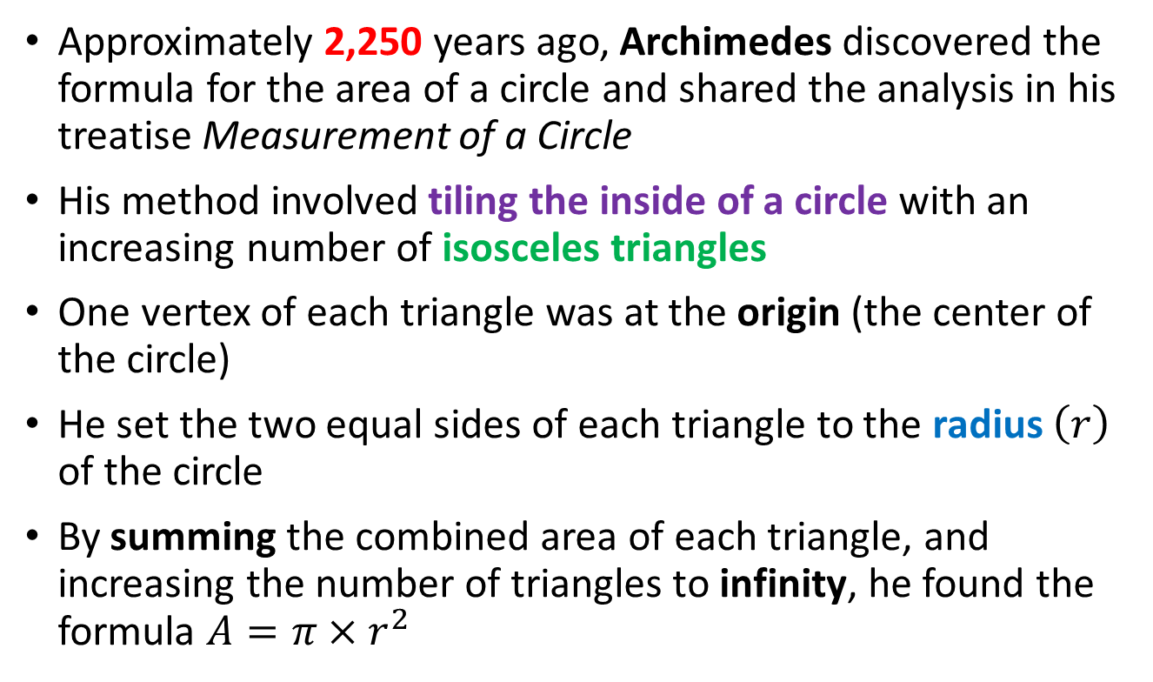
How Archimedes Found the Area of a Circle
Approximately 2,250 years ago, Archimedes discovered the formula for the area of a circle and shared the analysis in his treatise Measurement of a Circle
His method involved tiling the inside of a circle with an increasing number of isosceles triangles
One vertex of each triangle was at the origin (the center of the circle)
He set the two equal sides of each triangle to the radius $\left(r\right)$ of the circle
By summing the combined area of each triangle, and increasing the number of triangles to infinity, he found the formula $A=π×r^{2}$

Slide 4
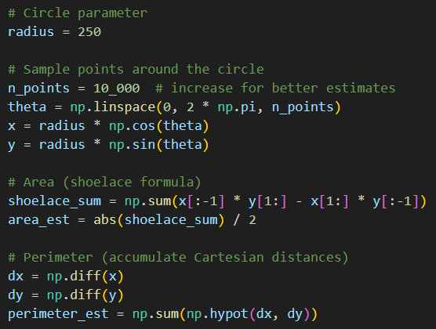
Open trig_circle.py
DO NOT edit
this code
①
②
③
④
Polar to Cartesian coordinate conversion
⑤
⑥
⑦
⑧

Slide 5
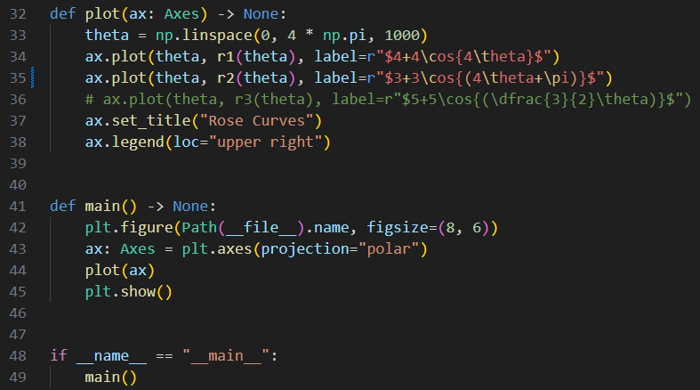
Edit rose_curves.py
You must EDIT this code
Uncomment line # 35

Slide 6
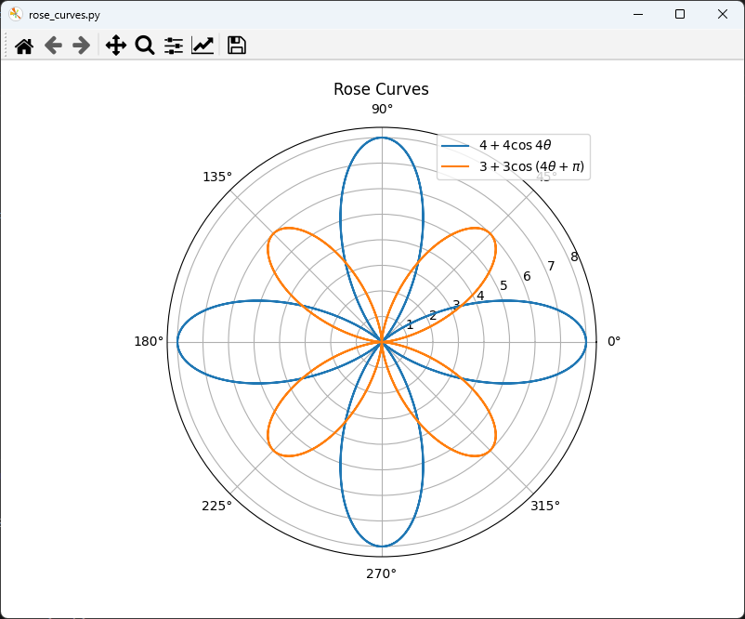

Run rose_curves.py
$$0≤θ≤4π$$

Slide 7
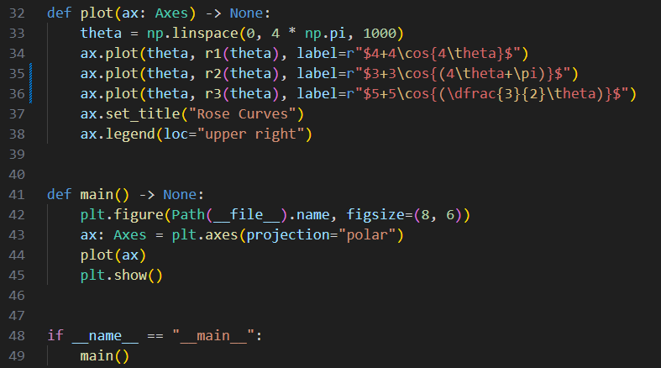
Edit rose_curves.py
You must EDIT this code
Uncomment line # 36

Slide 8
Session 08 – Now You Know…
How to use trigonometry to convert Polar coordinates to Cartesian coordinates
How to create polar projection graphs in matplotlib
How to use the shoelace formula to calculate the area enclosed by a polygon – with enough vertices, we can approximate the area of a smooth, closed, curved
There is no formula for the perimeter of an ellipse
That sinusoidal waves have amplitude, angular frequency, phase, and offsets
The addition (superposition) of even just two waves can yield surprisingly complicated system behavior

Slide 9
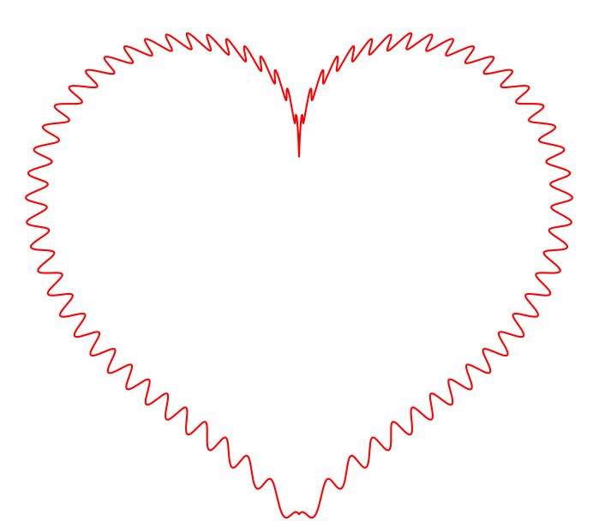
Task 08
Create a program called plot_heart.py that uses a matplotlib polar projection to draw the equation on slide #77

